Slide 1
Pipeline Repairs Improvement Project
Kick Off Meeting
Chuks. Bisike-Ojiako
Greg Esangbedo
Approved By: Emeka Maduekwe

Slide 2
OBJECTIVES OF THIS ENGAGMENT
Introduction & Background
Project Governance & Approvals
Data Analysis Outcome
Review & Sign off of Draft Project Charters
Project Schedule
Next Steps

Slide 3
Introduction & BACKGROUND
The Objectives of the entire project are:
To collate data with which to use to understand the lead times of actual pipeline repair and lead times of the associated services supporting pipeline repair
To provide a measure of actual performance of the pipeline repair process and the dependent services associated with the process.
To drive further improvements by showing potential areas (through data analysis) in which the current process can be improved
Completed
Completed
We are here ??

Slide 4
Project governance & APPROVALS
Governance
Janzen, Jurgen - Pipeline Asset Manager
Aganmwonyi, Agans - GM Security
Amadi, Amadi - HSE Manager
Mogbolu, Henry - Corporate Logistics Manager
Approvals & Sign offs (already received)
We have received approvals on the following
Sign off and approval of the data analysis outcome
Approval on Project Team constitution based on Data analysis outcome
Approval to drive the 2 projects through the Lean project maturation funnel based on data analysis outcome and the schedule
Agreed to include the Project delivery accountability in the GPAs of the persons nominated as PMs and Project Team members

Slide 5
DATA ANALYSIS outcome
The data analysis results indicated 2 key focus areas
PTW/Security Clearance process Improvement
Mobilization & JIV Execution process Improvement

Slide 6
PIPELINE REPAIR PROCESS IMPROVEMENT – PTW/SECURITY CLEARANCE
Business Case | Scope | Critical Success Factors/Initiative Categorization
It currently takes over 15 working days to carry out the various activities involved in the Permit-to-Work and security clearance process for emergency pipeline repairs irrespective of the type of repair or location in question. This is significantly longer than the period it takes to achieve similarly important activities in the overall pipeline repair process such as containment, JIV Preparation and FTO collection. This affects the overall efficiency of the delivery of pipeline repair services with attendant cost implications to Shell’s operations arising from deferments | The review of activities involved in processing PTW/Security clearance having regard to HSE requirements Review activities from the JIV preparation/FTO Collection process that constitute inputs into the PTW/Security Clearance process which currently take over 10 days to process | Shorter duration for achieving PTW/Security clearance flowing seamlessly into site mobilization/execution activities Alternatively simultaneous performance of some of the PTW/Security clearance activities with other activities thus eliminating current timeframe Seamless and fast delivery of the overall pipeline repair activities
Objectives | Deliverables/Timeline | Key FTE Requirement
To reduce the current time frame for performing PTW and security clearance activities by at least ......% without compromising HSE requirements Explore the possibility of carrying out these (or some of these) activities simultaneously with other activities thereby eliminating or significantly reducing the requisite timeframe | A reviewed shortened PTW/Security Clearance Process (30th July 2014) Earlier commencement of Site Mobilization/JIV Execution activities (30th July 2014) Standard Operating Procedure setting out the new activities/timelines for carrying out PTW/Security clearance 30th October 2014) | 1 Lean Coach: (4 months) 1 Project Manager: 4hrs/week (9 months) Other Team members: As required by the PM during the entire duration of the project
The Team | Benefits | Measures
Sponsor: Jurgen Janzen Project Manager: Asen Solomon Project Team members: Aisabokhale Tony, Erewa Johnson, Chikere Blaise, Owo Eneawaji Lean Coach: TBA | Reduction in cycle time for delivering pipeline repair activities with attendant improvement in uptake of dependant activities such as oil production activities Reduced loss of income arising from deferments attributable to defective pipelines Man hours savings from less time spent on pipeline repair activities; deployment for more value added activities | Time reduction in PTW/Security Clearance process as against current timeline Time reduction in completing the overall pipeline repairs process as against current timeline Overall % reduction in deferments attributable to delays in pipeline repair

Slide 7
PIPELINE REPAIR PROCESS IMPROVEMENT – SITE MOBILIZATION/JIV EXECUTION
Business Case | Scope | Critical Success Factors/Initiative Categorization
Mobilization to site to perform pipeline repair activities currently takes between 30 -35 working days depending on the type of site. This excludes an additional 20 days or so spent on JIV execution. This, in addition to other delays experienced in various other aspects of the repair process increases the overall duration for carrying out pipeline repairs. This affects the efficiency of the delivery of pipeline repair services with attendant loss of income to the Company arising from production deferments | The review of activities involved in site mobilization and JIV execution Activities from the PTW/Security Clearance process that constitute inputs into the mobilization/JIV execution process | Shorter duration for achieving site mobilization/JIV execution activities flowing seamlessly into Site execution/closeout activities Seamless and fast delivery of the overall pipeline repair activities
Objectives | Deliverables/Timeline | Key FTE Requirement
To reduce the current time frame for mobilizing to site and JIV execution by at least ...% without compromising HSE requirements | A shortened Mobilization to site/JIV execution Process (31st July 2014) Earlier commencement of Site execution/closeout activities (31st July 2014) Standard Operating Procedure setting out the new activities/timelines for carrying out mobilization to site/JIV Execution activities (31st October 2014) | 1 Lean Coach: (4 months) 1 Project Manager: 4hrs/week (9 months) Other Team members: As required by the PM during the entire duration of the project
The Team | Benefits | Measures
Sponsors: Jurgen Janzen, Project Manager: Babs Olayinka Project Team members: Anibasa Usman, Ujah Cletus, Evboifo Isaac, Soluade Michael Lean Coach: Gregory Esangbedo | Reduced cycle time for delivering pipeline repair activities with attendant improvement in uptake of dependant activities such as oil production activities Reduced loss of income arising from deferments attributable to defective pipelines Man hours savings from less time spent on pipeline repair activities; deployment of such time for more value added activities | Time reduction in site mobilization/JIV excution as against current timeline Time reduction in completing the overall pipeline repairs process as against current timeline Overall % reduction in deferments attributable to delays in pipeline repair

Slide 8
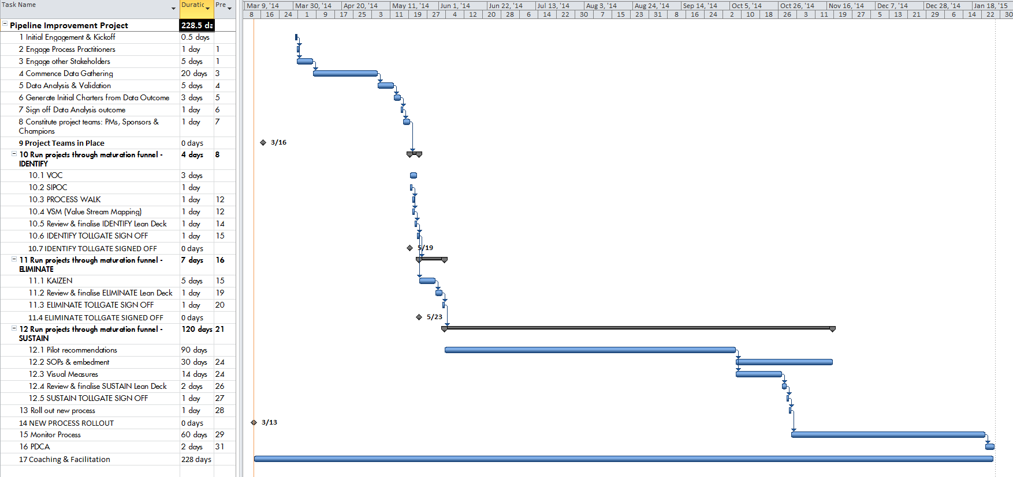
Pipeline improvement project- project schedule
We are already behind and will need to move quickly

Slide 9
NEXT STEPS
Based on the Schedule, the following is proposed
3rd of July (Full day) – Map VS for both Teams
4th of July (Half day) – Finalise & Validate VSM
Kaizen Event for the 2 project teams
8th –11th July
15th –18th July
PMs to coordinate logistics – Venue, etc
CI Coach to provide requirements and support

